Slide 1
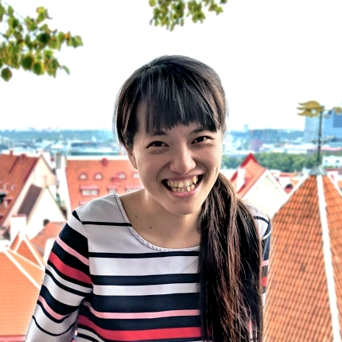

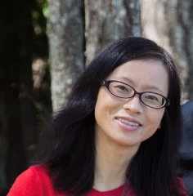


Aesthetic Experience is Influenced by
Causality in Biological Movements
Yi-Chia Chen
Frank Pollick
Hongjing Lu

Slide 2
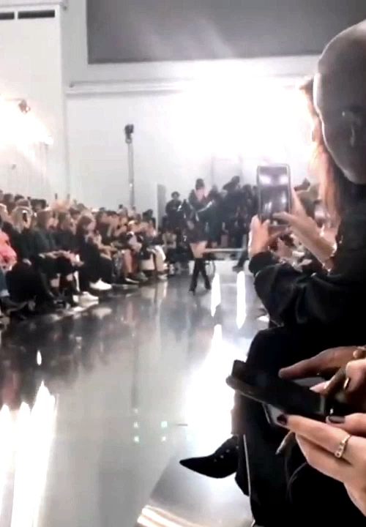

Slide 3

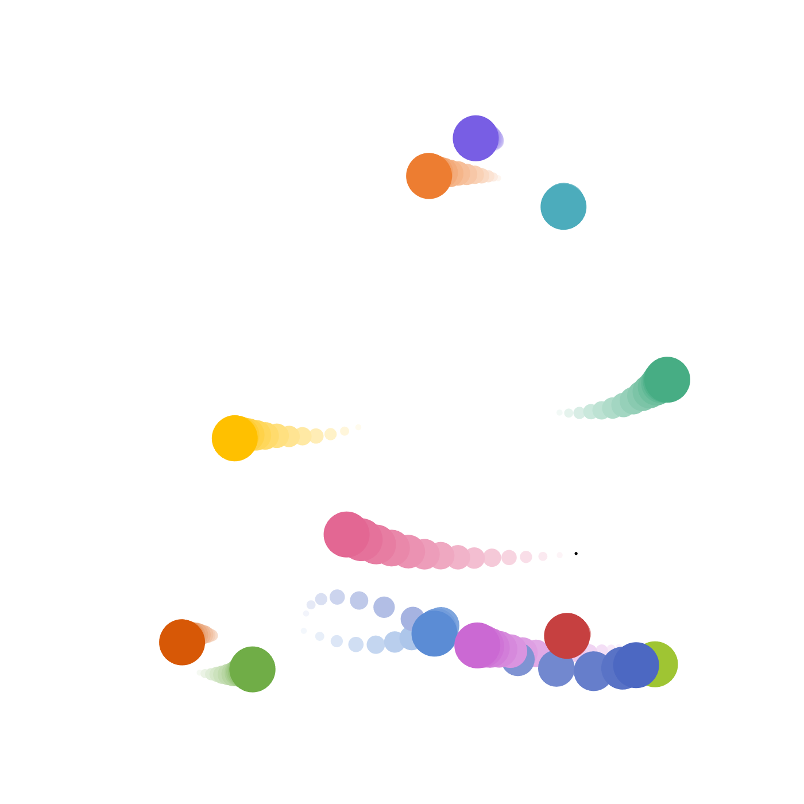
Stimuli — Point-light Walkers
1 walker
20 versions

Slide 4
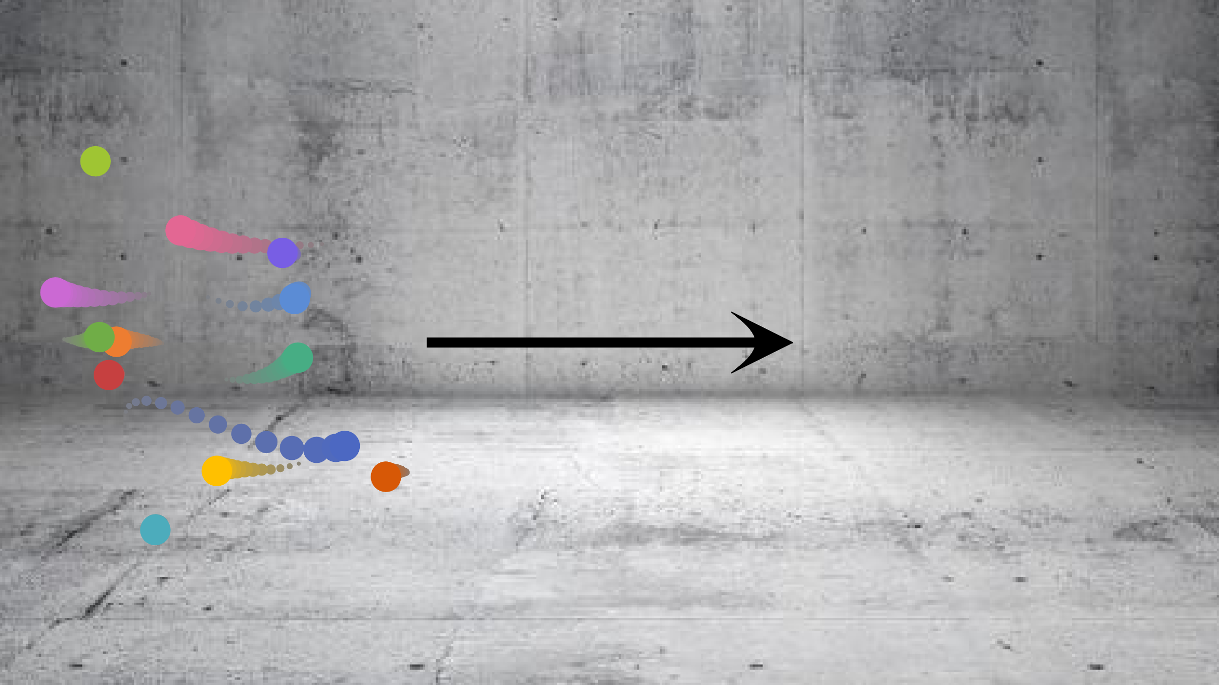
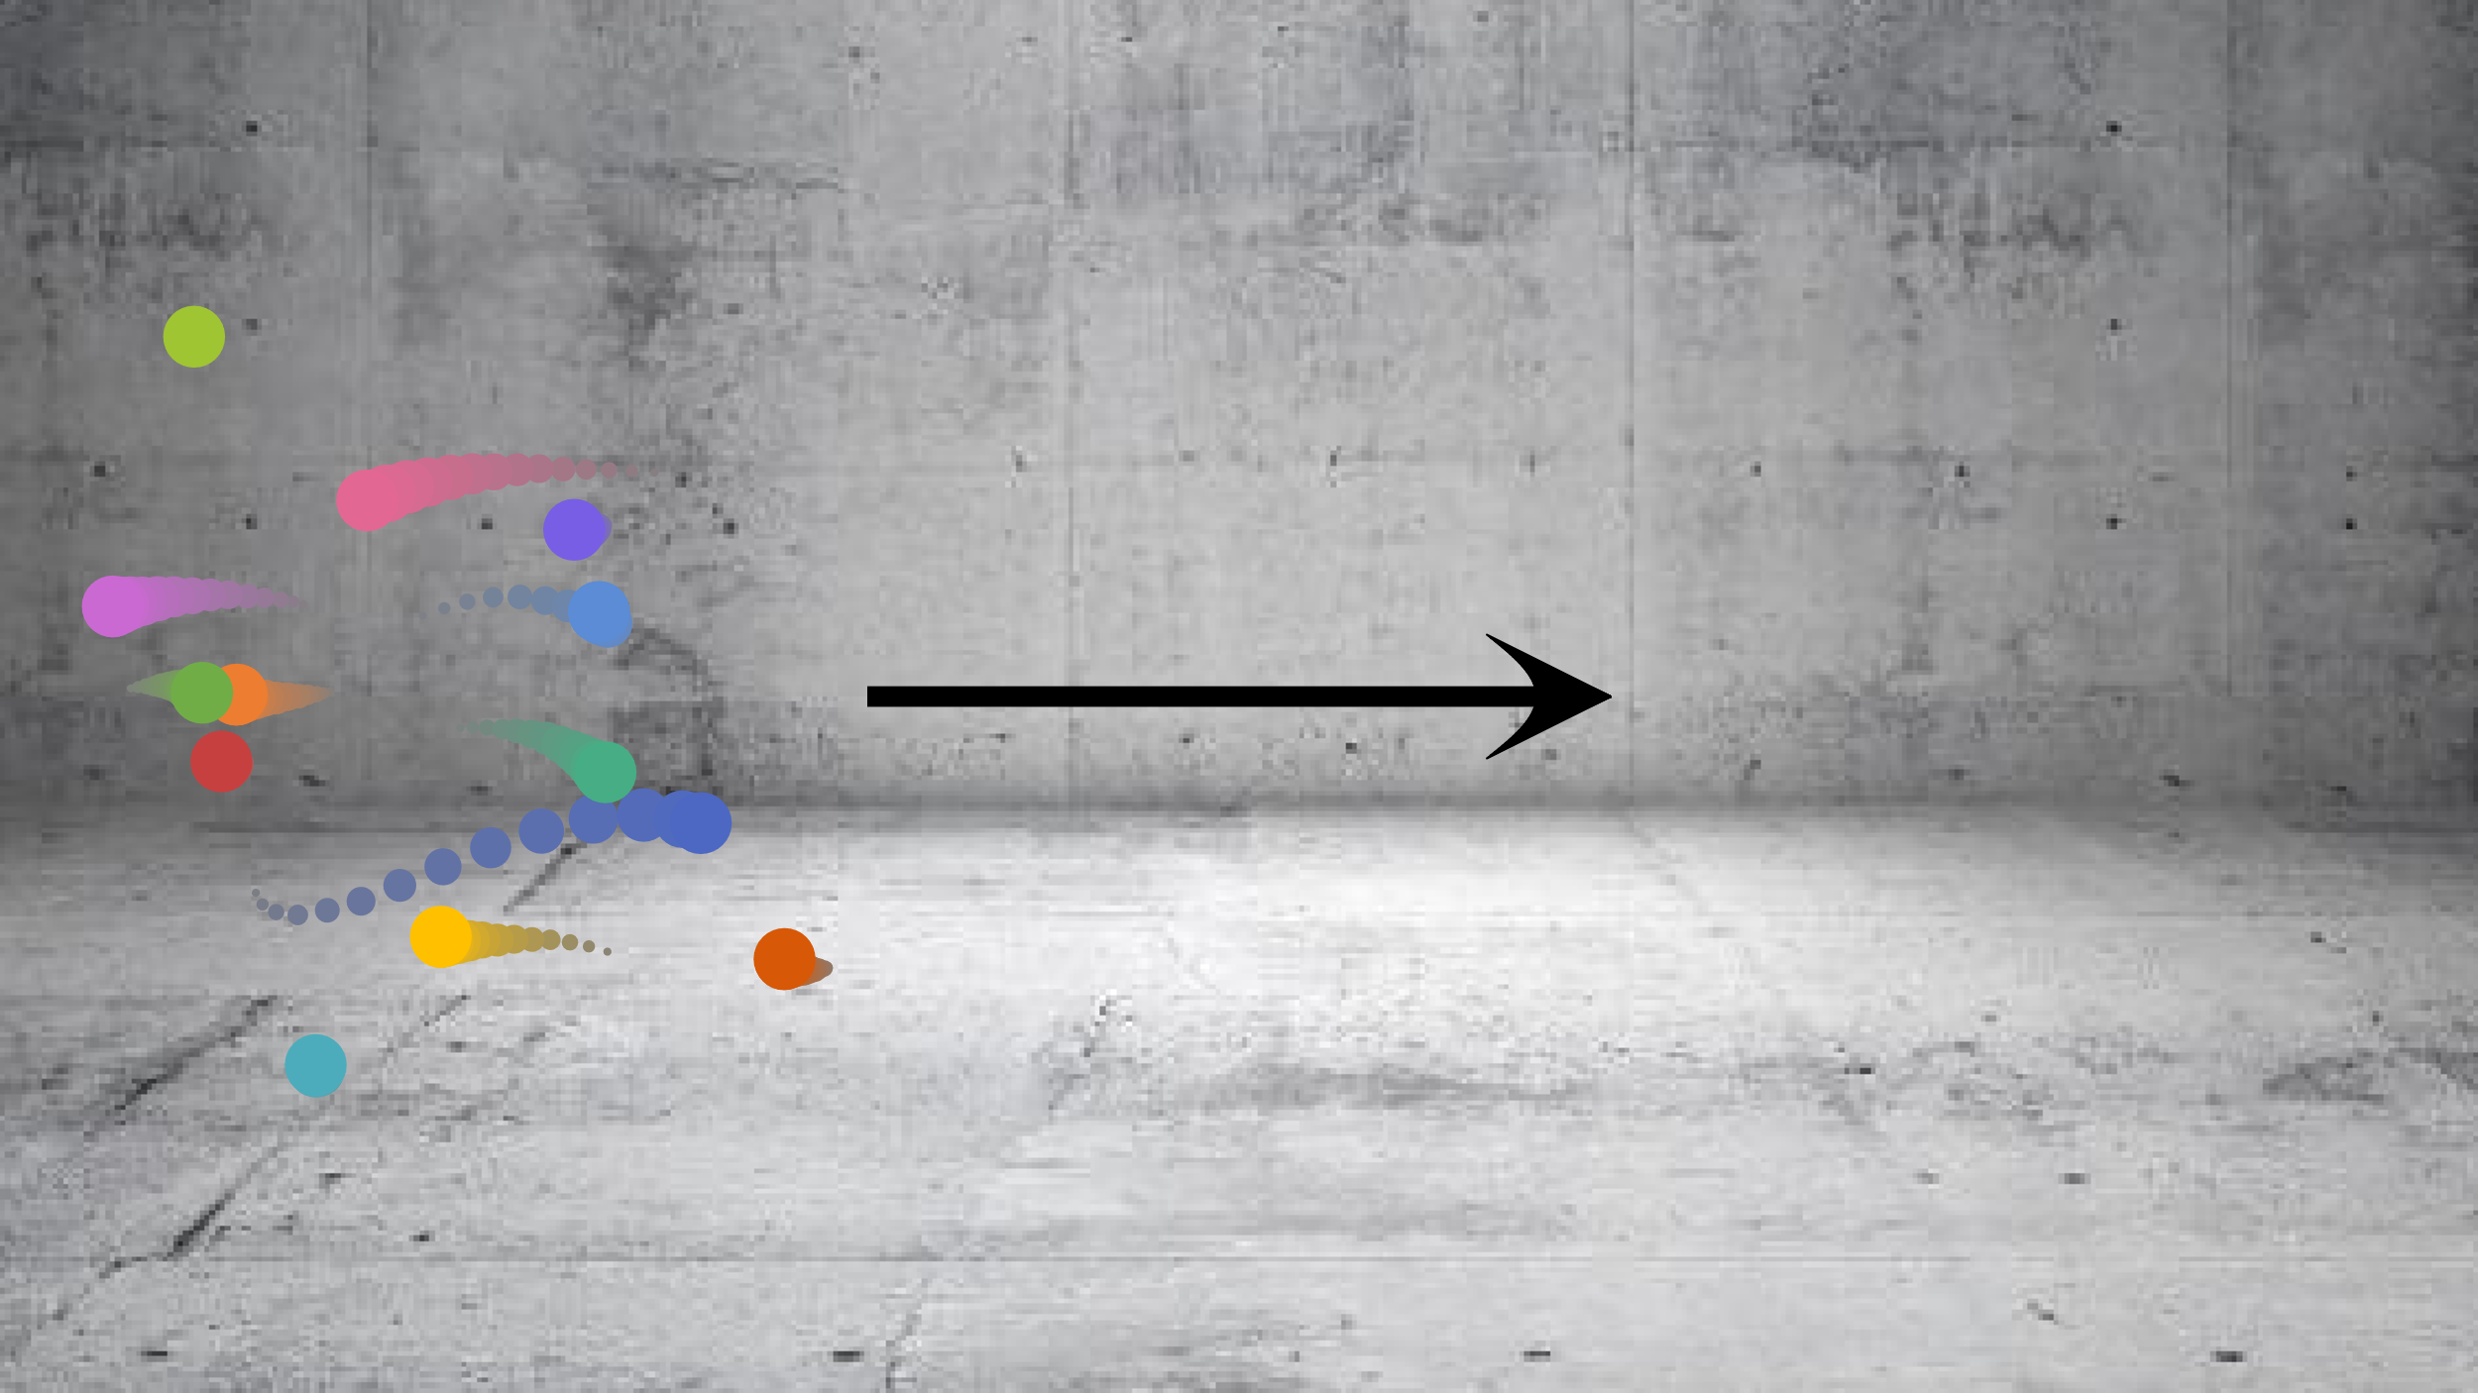
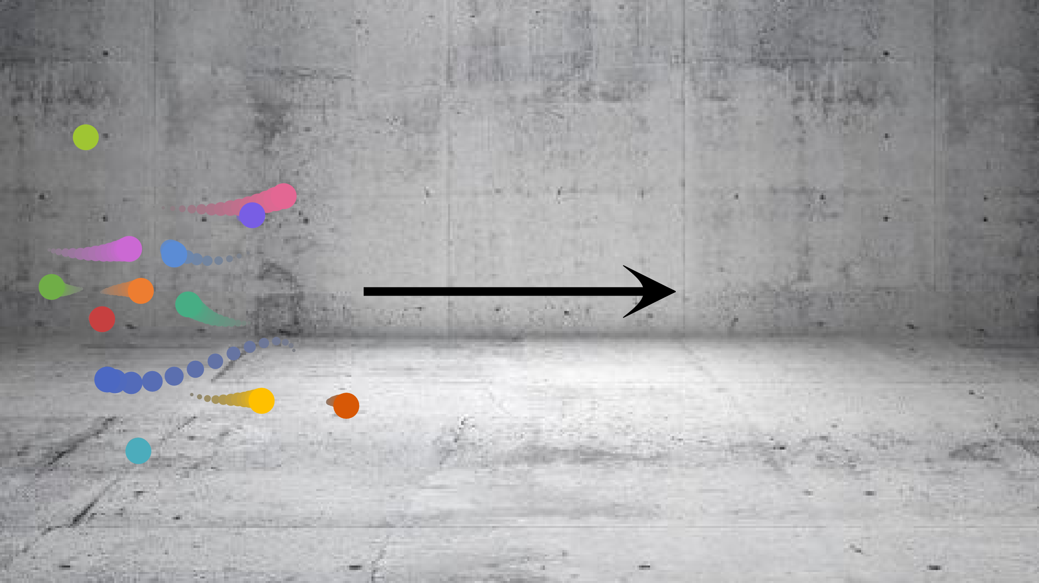
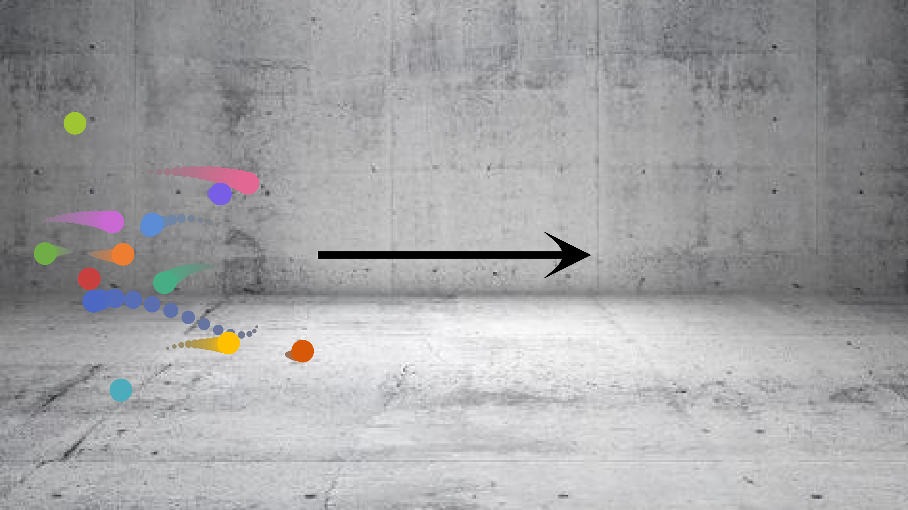
Manipulations — Causal Features
Upright Trajectories
Inverted Trajectories
Expt 2
Exhibit
Gravitational acceleration
Defy gravity
Global motion
Congruent
With propelling forces
Global motion
Incongruent
With propelling forces
(as in Moon Walk)

Slide 5
Conclusions
Visual processes contribute to aesthetics of motions
Specialized mechanisms
For animate agents
General motion
perception
We have a taste for causality!

